Slide 1
Computer Vision

Slide 2

Agenda
01
The What
02
The How
03
The Huh?
04
The Why
05
The “Oh Cool!”

Slide 3

The What

Slide 4
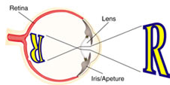
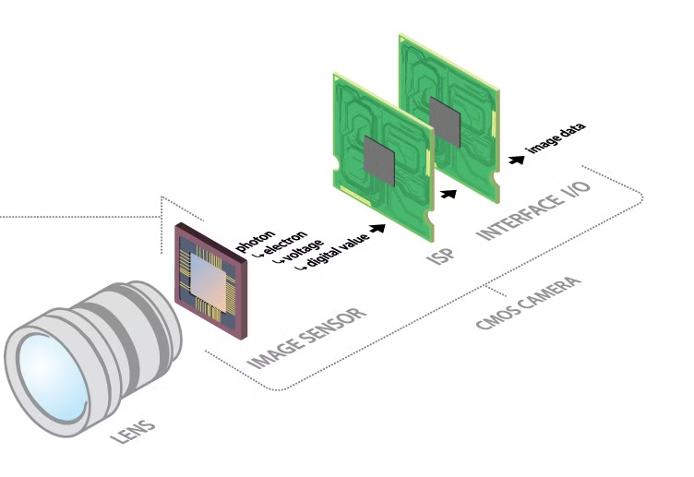
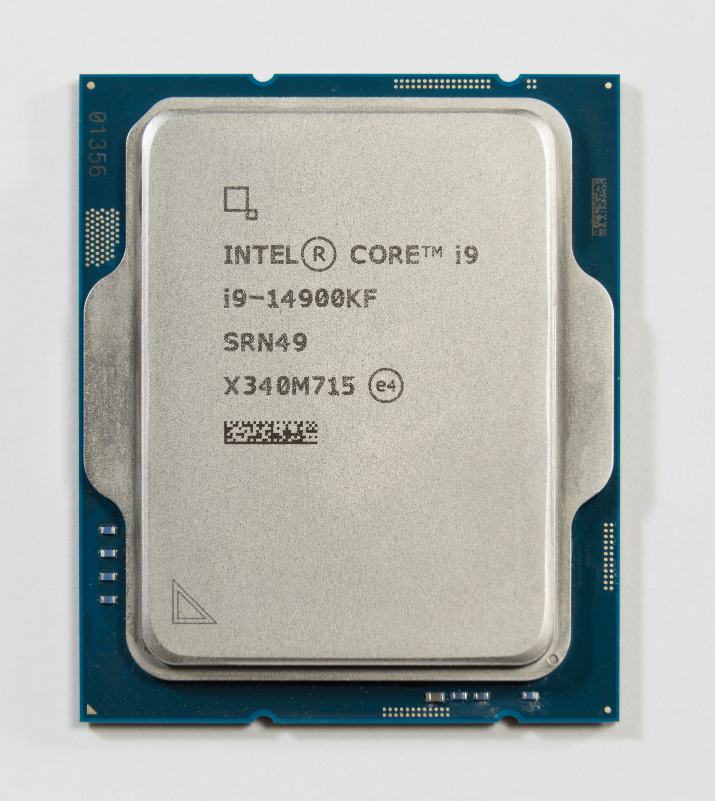
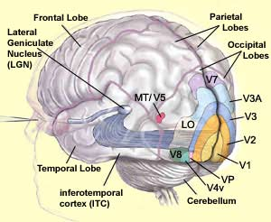

The What
Human Image Processing
Computer Image Processing
“Looks like a tree!”
Notes:
Highlight Key Feature – {Talking points on the highlighted key feature here}

Slide 5
The How

Slide 6
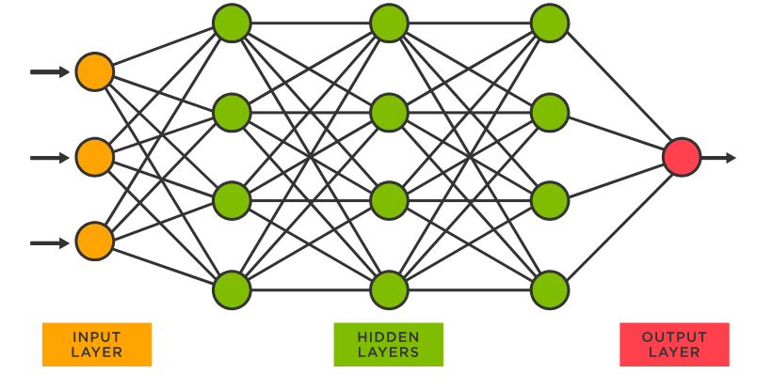
The How
Notes:
Highlight Key Feature – {Talking points on the highlighted key feature here}

Slide 7
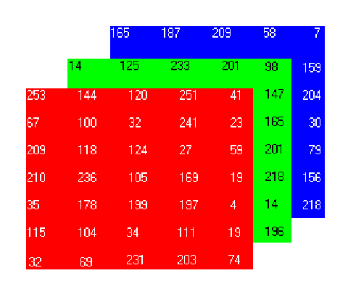
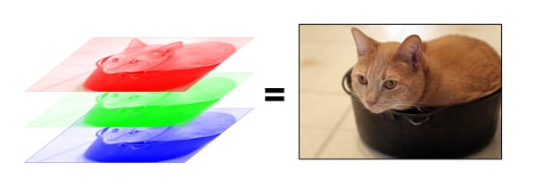
The How
1. Understand the image
Notes:
Highlight Key Feature – {Talking points on the highlighted key feature here}

Slide 8
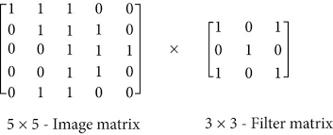
The How
1. Understand the image
2. Apply filters
Notes:
Highlight Key Feature – {Talking points on the highlighted key feature here}

Slide 9
The How
1. Understand the image
2. Apply filters
Notes:
Highlight Key Feature – {Talking points on the highlighted key feature here}

Slide 10
The How
1. Understand the image
2. Apply filters
Resulting matrix: a likelihood that the filters pattern is present at that location
Different filters detect different features or manipulate an image different ways.
Edges, curves, textures, blurring, sharpening, etc.
Notes:
Highlight Key Feature – {Talking points on the highlighted key feature here}

Slide 11
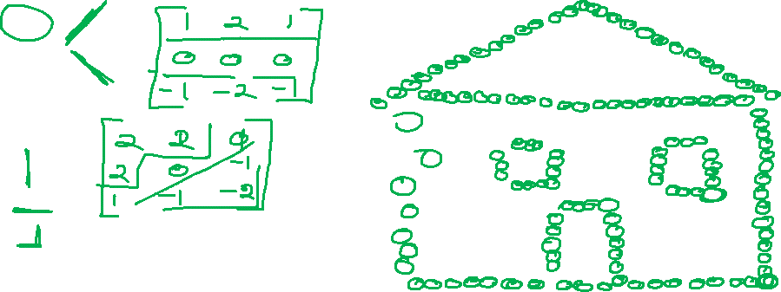

The How
Pictionary Anyone?
Notes:
Highlight Key Feature – {Talking points on the highlighted key feature here}

Slide 12
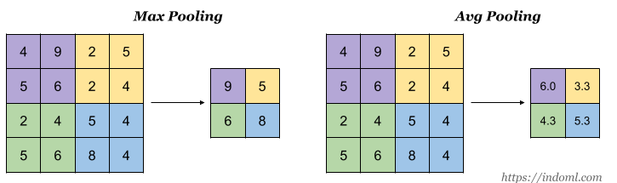

The How
1. Understand the image
Downsampling reduces the volume of information to process, while pooing preserves the import features.
2. Apply filters
2. Downsample by pooling
Notes:
Highlight Key Feature – {Talking points on the highlighted key feature here}

Slide 13
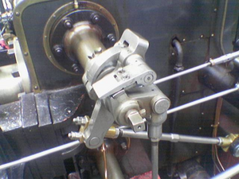
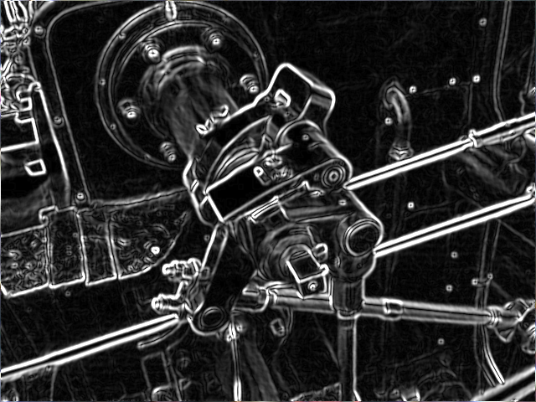
The How
1. Understand the image
2. Apply filters
2. Downsample by pooling
Notes:
Highlight Key Feature – {Talking points on the highlighted key feature here}

Slide 14
The Huh?

Slide 15
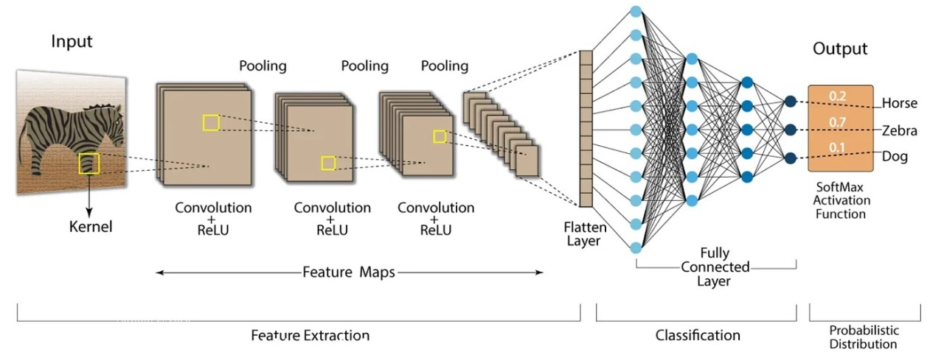

The Huh?
Notes:
Highlight Key Feature – {Talking points on the highlighted key feature here}

Slide 16

The Huh?
Notes:
Highlight Key Feature – {Talking points on the highlighted key feature here}

Slide 17
The Why

Slide 18
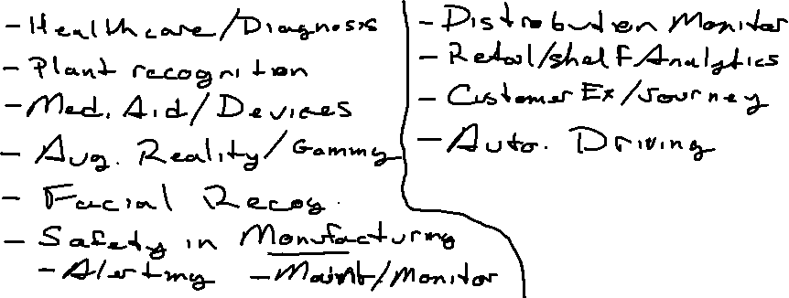
The Why
Use Cases?
Notes:
Highlight Key Feature – {Talking points on the highlighted key feature here}

Slide 19
The Why
Use Cases
Image Classification
Product Categorization: Sorting products in e-commerce platforms (apparel, electronics, groceries) for better search and recommendations.
Quality Control: Inspecting manufactured goods for defects (e.g., cracks in machinery parts, blemishes on food).
Medical Imaging: Analyzing X-rays, MRIs, and CT scans to detect abnormalities (tumors, fractures).
Remote Sensing: Classifying land cover (forests, urban areas, water bodies) from satellite imagery.
Project Manager/Business Analyst Perspective:
Increased Efficiency: Automate tasks that previously required manual inspection, saving time and resources.
Improved Accuracy: Reduce human error in classification tasks, leading to more reliable and consistent outcomes.
Data-Driven Insights: Gain valuable insights from visual data that can inform business decisions (e.g., market trends, customer behavior).
Notes:
Highlight Key Feature – {Talking points on the highlighted key feature here}

Slide 20
The Why
Use Cases
Object Detection
Autonomous Vehicles: Detecting pedestrians, vehicles, and traffic signs for safe navigation.
Surveillance Systems: Identifying and tracking objects of interest (e.g., suspicious activity, missing persons).
Retail: Analyzing customer behavior in stores (e.g., identifying product interactions, counting customers) to optimize store layout and marketing strategies.
Agriculture: Monitoring crop health, detecting pests and diseases in plants.
Project Manager/Business Analyst Perspective:
Enhanced Safety: Improve safety in various applications (e.g., autonomous vehicles, industrial settings).
Improved Efficiency: Automate tasks that require visual inspection and object identification.
Data-Driven Decision Making: Gain valuable insights from visual data to optimize business processes and improve operational efficiency.
Notes:
Highlight Key Feature – {Talking points on the highlighted key feature here}

Slide 21
The “Oh Cool!”

Slide 22

The What
Time to give it a try!
https://revachat.azurewebsites.net
“Vision” page in the navbar
250121AIUpskill
Limited to .png, .jpg, .jpeg, and .gif format
Notes:
Highlight Key Feature – {Talking points on the highlighted key feature here}

Slide 23
Thank You!

